Slide 1
GRADE 7 ACCELERATED · UNIT 4 · LESSON 6
Order of Operations with Radicals
MA.8.NSO.1.7
I can evaluate a multi-step expression with rational numbers, exponents and radicals by reading its structure.
Yesterday the radical bar grouped whatever sat under it.
Today every grouping symbol at once — and the order comes from the structure, not from a mnemonic.
Grade 7 Accelerated · Unit 4 · Lesson 6 — Order of Operations with Radicals
1

Slide 2
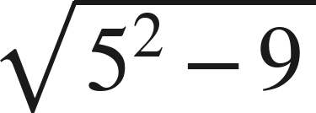


Warm-Up
On your own. Four minutes. No notes.
1.
2. How many significant digits are in 1.020 ?
3. Find the value:
4. Evaluate:
Grade 7 Accelerated · Unit 4 · Lesson 6 — Order of Operations with Radicals
2

Slide 3
Warm-Up
Answers.
1.
4
2. How many significant digits are in 1.020 ?
4
3. Find the value:
9/4
4. Evaluate:
8
Grade 7 Accelerated · Unit 4 · Lesson 6 — Order of Operations with Radicals
3

Slide 4
Notes
Copy the table.
I. The structure, not a mnemonic
 | Level | What it means
1 | Grouping symbols | ( ), [ ], the radical bar, the fraction bar
2 | Powers and roots | the same level as each other
3 | Multiply and divide | left to right
4 | Add and subtract | left to right
Innermost grouping symbol first, then out.
Grade 7 Accelerated · Unit 4 · Lesson 6 — Order of Operations with Radicals
4

Slide 5


Notes
II. Left to right means left to right
, never
, never
Multiplication and division are one level. Addition and subtraction are one level. Left to right, both times.
Grade 7 Accelerated · Unit 4 · Lesson 6 — Order of Operations with Radicals
5

Slide 6
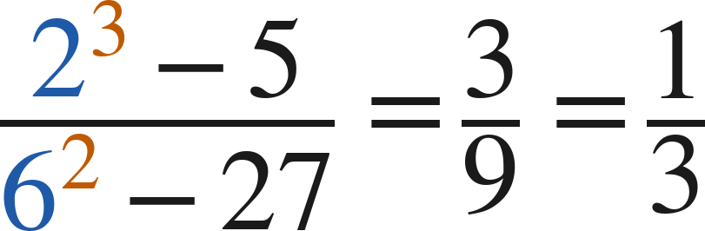
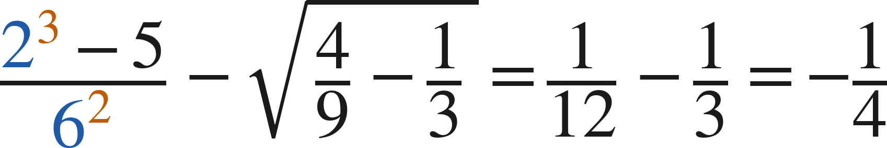
Notes
III. The fraction bar groups, top and bottom
Finish the numerator and finish the denominator before you divide.
Grade 7 Accelerated · Unit 4 · Lesson 6 — Order of Operations with Radicals
6

Slide 7
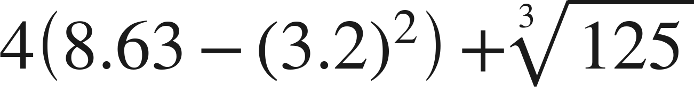
Example 1
A grouping symbol inside a grouping symbol.
Evaluate.
Grade 7 Accelerated · Unit 4 · Lesson 6 — Order of Operations with Radicals
7

Slide 8
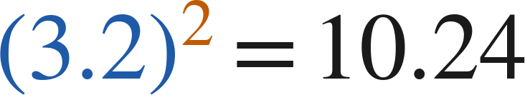

Example 1
Worked.
innermost: the power inside the parentheses
finish the parentheses, then multiply
the cube root is 5; add last
Answer: −1.44
Grade 7 Accelerated · Unit 4 · Lesson 6 — Order of Operations with Radicals
8

Slide 9
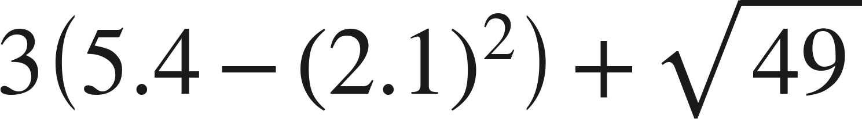
Your Turn
Same steps, your numbers. Boards up when done.
Grade 7 Accelerated · Unit 4 · Lesson 6 — Order of Operations with Radicals
9

Slide 10
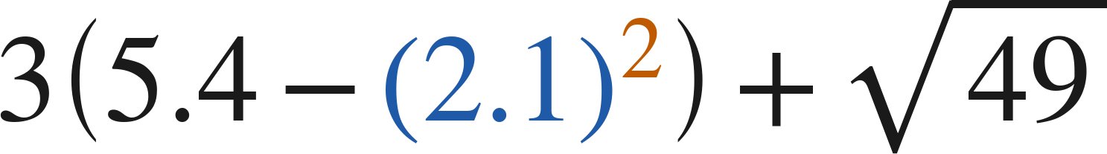
Your Turn
Answer.
3(0.99) + 7
Answer: 9.97
Grade 7 Accelerated · Unit 4 · Lesson 6 — Order of Operations with Radicals
10

Slide 11
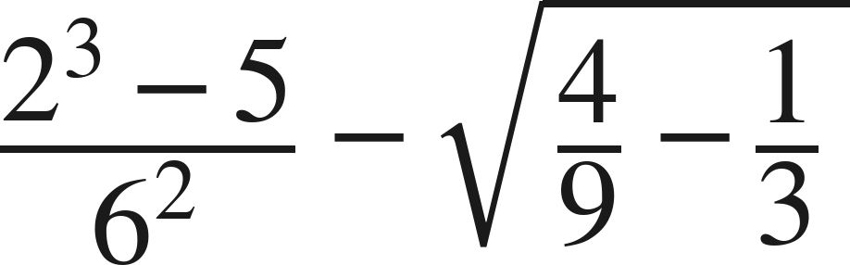
Example 2
A fraction bar and a radical in one expression.
Evaluate.
Grade 7 Accelerated · Unit 4 · Lesson 6 — Order of Operations with Radicals
11

Slide 12
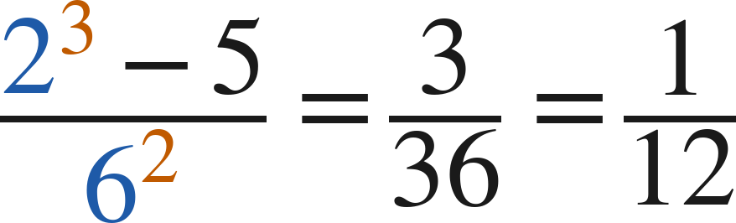
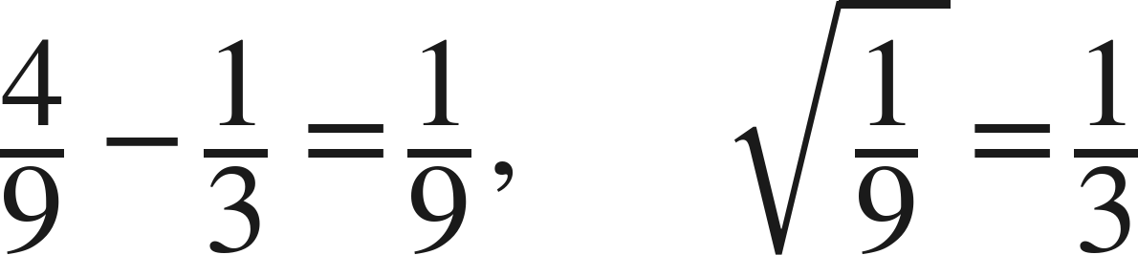
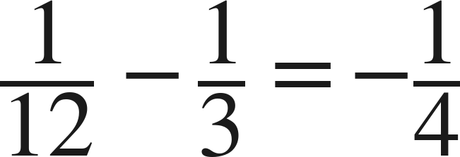
Example 2
Worked.
numerator and denominator, each finished
under the bar, then the root
subtract last
Answer: −1/4
Grade 7 Accelerated · Unit 4 · Lesson 6 — Order of Operations with Radicals
12

Slide 13
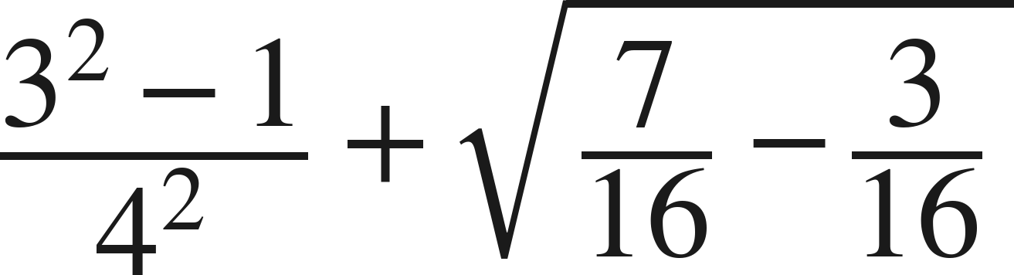
Your Turn
Same steps, your numbers. Boards up when done.
Grade 7 Accelerated · Unit 4 · Lesson 6 — Order of Operations with Radicals
13

Slide 14
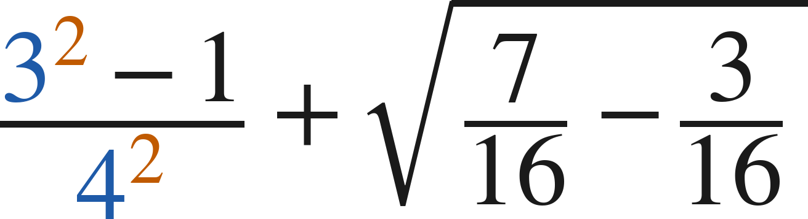
Your Turn
Answer.
a half plus a half
Answer: 1
Grade 7 Accelerated · Unit 4 · Lesson 6 — Order of Operations with Radicals
14

Slide 15

Whiteboards · Question 1 of 9
Boards up on three.
Answer it.
Left to right.
Grade 7 Accelerated · Unit 4 · Lesson 6 — Order of Operations with Radicals
15

Slide 16

Whiteboards · Question 1 of 9
Answer.
12 ÷ 3 first
Answer: 8
Grade 7 Accelerated · Unit 4 · Lesson 6 — Order of Operations with Radicals
16

Slide 17
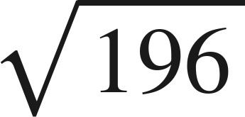
Whiteboards · Question 2 of 9
Boards up on three.
A square tile has side
centimetres.
Its diagonal is about 19.8 centimetres.
What is the perimeter of the tile?
Answer it.
Find the side, then the perimeter.
Grade 7 Accelerated · Unit 4 · Lesson 6 — Order of Operations with Radicals
17

Slide 18
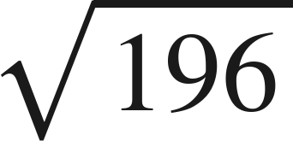
Whiteboards · Question 2 of 9
Answer.
A square tile has side
centimetres.
Its diagonal is about 19.8 centimetres.
What is the perimeter of the tile?
4 sides of 14
Answer: 56 centimetres
Grade 7 Accelerated · Unit 4 · Lesson 6 — Order of Operations with Radicals
18

Slide 19

Whiteboards · Question 3 of 9
Boards up on three.
Answer it.
Left to right.
Grade 7 Accelerated · Unit 4 · Lesson 6 — Order of Operations with Radicals
19

Slide 20

Whiteboards · Question 3 of 9
Answer.
10 − 4 first
Answer: 9
Grade 7 Accelerated · Unit 4 · Lesson 6 — Order of Operations with Radicals
20

Slide 21
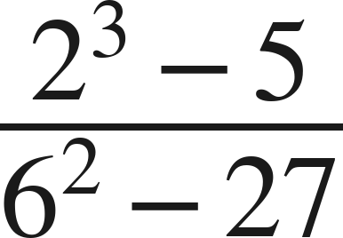
Whiteboards · Question 4 of 9
Boards up on three.
Answer it.
Finish the top and the bottom.
Grade 7 Accelerated · Unit 4 · Lesson 6 — Order of Operations with Radicals
21

Slide 22
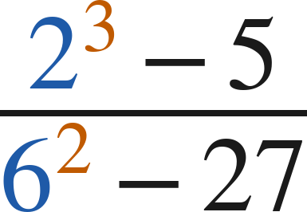
Whiteboards · Question 4 of 9
Answer.
3 over 9
Answer: 1/3
Grade 7 Accelerated · Unit 4 · Lesson 6 — Order of Operations with Radicals
22

Slide 23
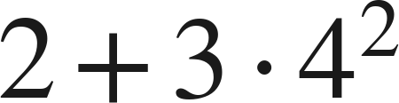
Whiteboards · Question 5 of 9
Boards up on three.
Which is the value?
A. 146
B. 50
C. 26
D. 80
Answer it.
Grade 7 Accelerated · Unit 4 · Lesson 6 — Order of Operations with Radicals
23

Slide 24
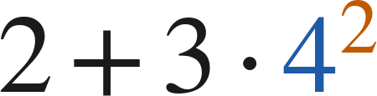
Whiteboards · Question 5 of 9
Answer.
Which is the value?
A. 146
B. 50
C. 26
D. 80
Answer: B — 50
Grade 7 Accelerated · Unit 4 · Lesson 6 — Order of Operations with Radicals
24

Slide 25
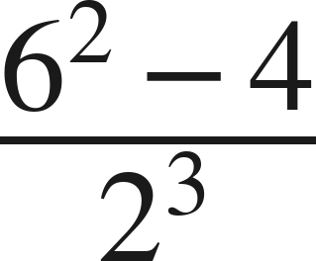
Whiteboards · Question 6 of 9
Boards up on three.
Which is the value?
A. 4
B. 35.5
C. 0.5
D. 256
Answer it.
Grade 7 Accelerated · Unit 4 · Lesson 6 — Order of Operations with Radicals
25

Slide 26
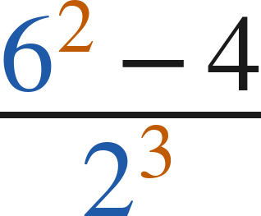
Whiteboards · Question 6 of 9
Answer.
Which is the value?
A. 4
B. 35.5
C. 0.5
D. 256
Answer: A — 4
Grade 7 Accelerated · Unit 4 · Lesson 6 — Order of Operations with Radicals
26

Slide 27
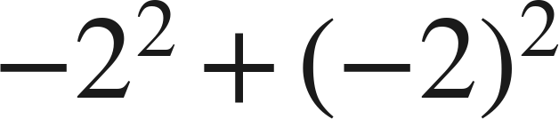
Whiteboards · Question 7 of 9
Boards up on three.
Answer it.
What is each exponent attached to?
Grade 7 Accelerated · Unit 4 · Lesson 6 — Order of Operations with Radicals
27

Slide 28
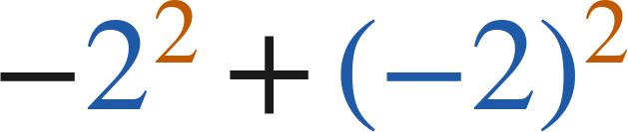
Whiteboards · Question 7 of 9
Answer.
−4 and +4
Answer: 0
Grade 7 Accelerated · Unit 4 · Lesson 6 — Order of Operations with Radicals
28

Slide 29
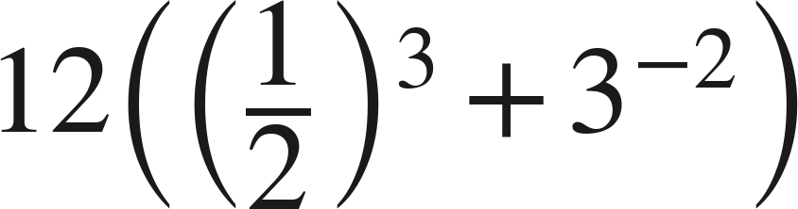
Whiteboards · Question 8 of 9
Boards up on three.
Answer it.
Inside first.
Grade 7 Accelerated · Unit 4 · Lesson 6 — Order of Operations with Radicals
29

Slide 30
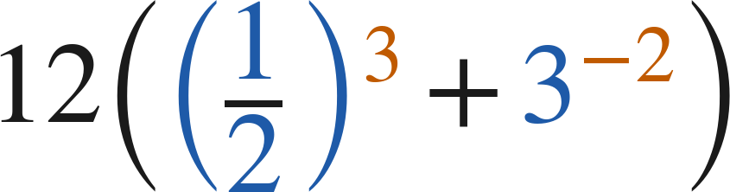
Whiteboards · Question 8 of 9
Answer.
one eighth plus one ninth
Answer: 17/6
Grade 7 Accelerated · Unit 4 · Lesson 6 — Order of Operations with Radicals
30

Slide 31
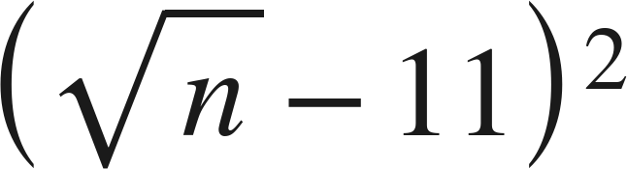

Whiteboards · Question 9 of 9
Take your time. Boards up when you have written it.
Roscoe says that
is always positive,
because a square is always positive.
Is he right? Give a value of
that settles it.
Write your answer in sentences.
Try to make the inside zero.
Grade 7 Accelerated · Unit 4 · Lesson 6 — Order of Operations with Radicals
31

Slide 32

Whiteboards · Question 9 of 9
Answer.
Roscoe says that
is always positive,
because a square is always positive.
Is he right? Give a value of
that settles it.
never negative is not the same as always positive
Answer: No — at n = 121 the value is 0
Grade 7 Accelerated · Unit 4 · Lesson 6 — Order of Operations with Radicals
32

Slide 33
Independent Set
Six questions. On your own, in silence.
1.
Six questions. Work down the page.
2.
Show the step that does the work, not just the answer.
3.
Silence until the six minutes are up.
Grade 7 Accelerated · Unit 4 · Lesson 6 — Order of Operations with Radicals
33

Slide 34
IXL
Last five minutes.
1.
Open IXL and start today's skills.
2.
Work on paper where the question needs work. The answer box does not show it.
3.
Every skill listed is required, to a SmartScore of 67. Due at the start of the next class.
Today's skills — all required
Evaluate radical expressions — D8J
Grade 7 Accelerated · Unit 4 · Lesson 6 — Order of Operations with Radicals
34

